Slide 1

Investor Pitch Deck
WTG Nicosia
Find the vibe tonight
Real-time nightlife discovery for international students in Nicosia.
Live Yes voters
Map + Events
Venue tools (phased)
See where people plan to go in real time.
Discover venues and upcoming nights quickly.
Bookings, guest lists, deals, and analytics.
WTG Nicosia | Confidential
WTG Nicosia | 2025

Slide 2
Problem
International students struggle to choose where to go out — and waste nights on the wrong vibe.
Lack of local knowledge about good places to go
Fear of arriving to empty or boring venues
Hard to coordinate plans and see where the crowd is going
Fragmented info about events, student nights, deals, and safety
Market signal
More than 15,000 students enter Nicosia per year (from project docs).
WTG Nicosia | Confidential
Problem

Slide 3
Solution
WTG Nicosia makes going out effortless by combining discovery with real-time social signals.
Real-time vibe
Discover faster
Venue operations (phased)
Live Yes voters + status signals reduce uncertainty and help groups decide.
Map + curated venues/events designed for student nightlife workflows.
Bookings, guest lists, deals, occupancy, and analytics create B2B value.
WTG Nicosia | Confidential
Solution

Slide 4
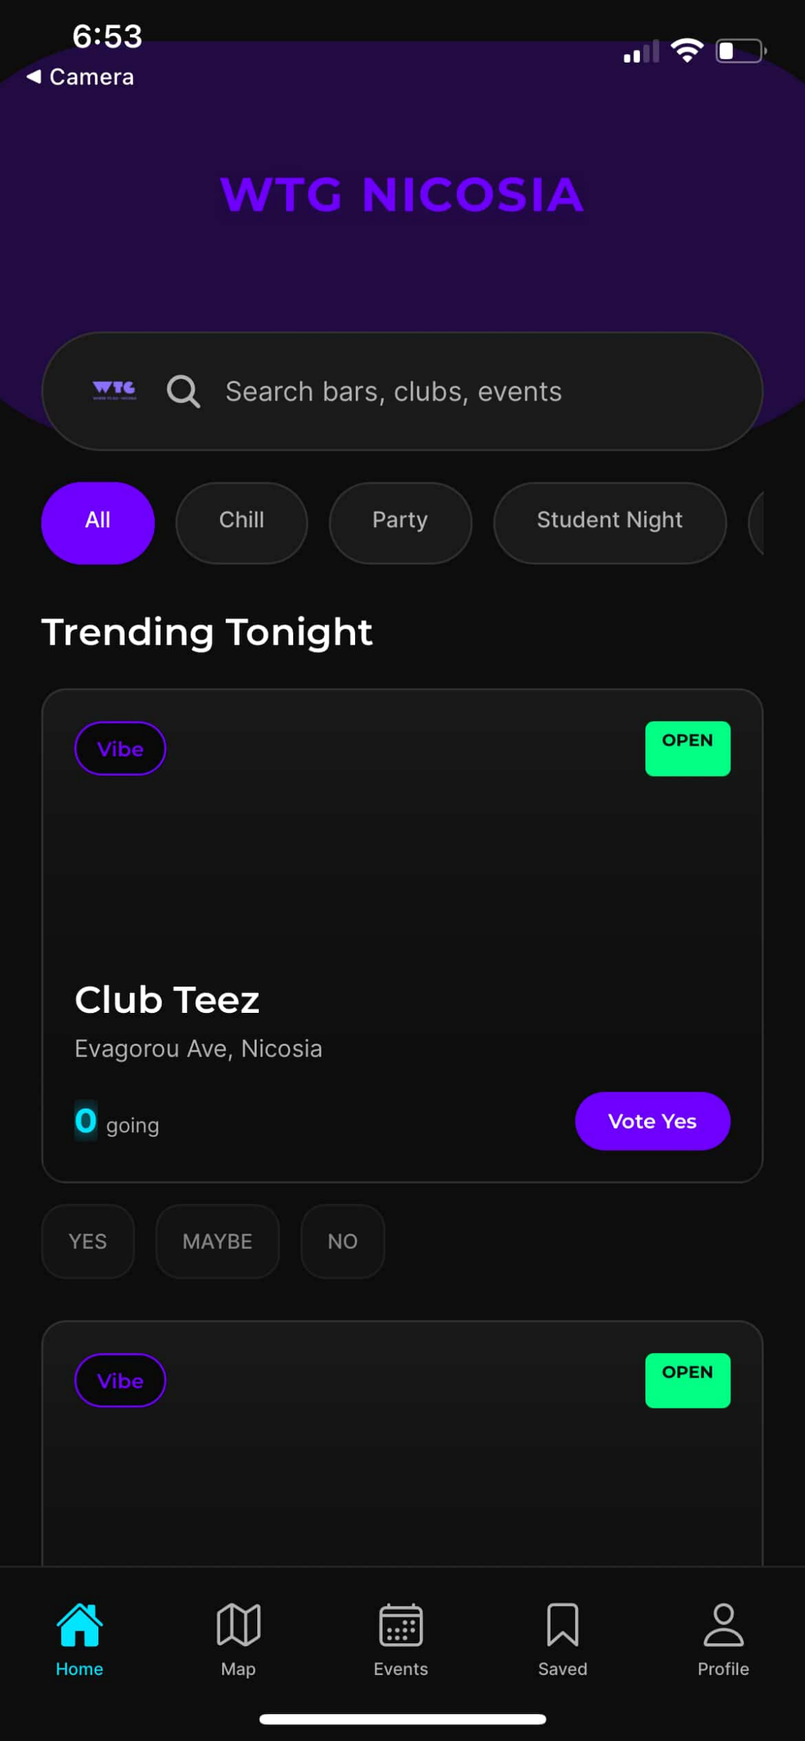
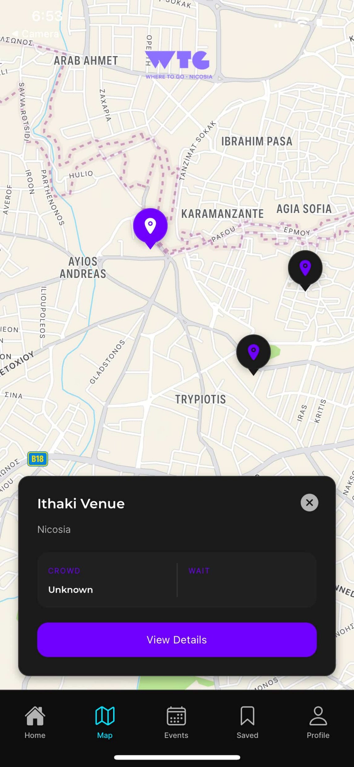
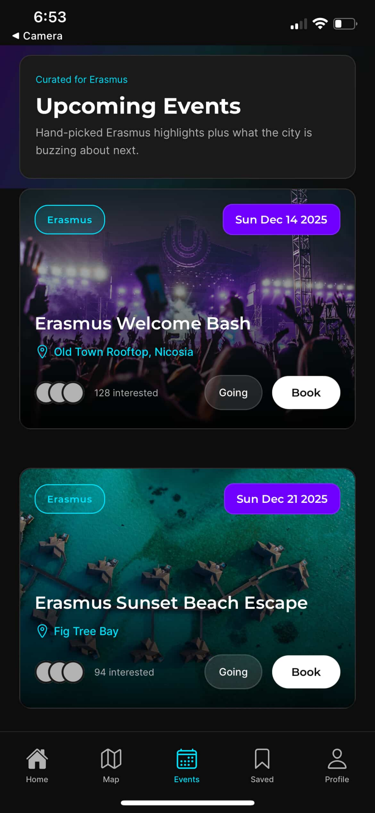
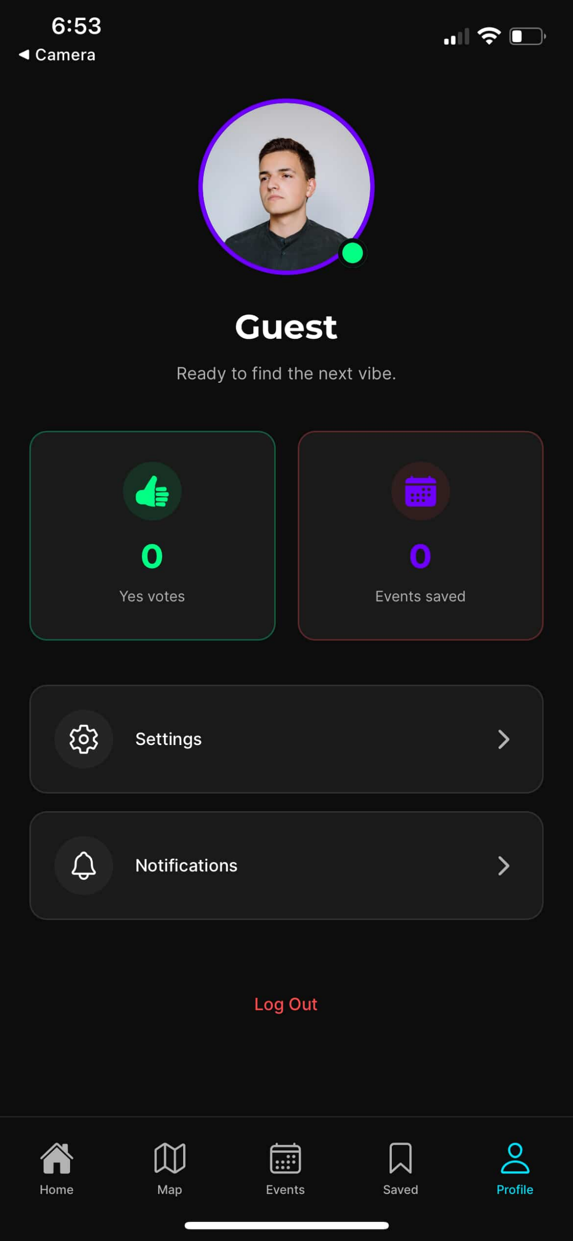
Product Demo (MVP Screens)
Prototype is implemented in the repo; replace these placeholders with screenshots for the live pitch.
Home
Map
Events
Profile
WTG Nicosia | Confidential
Product

Slide 5

Market
Primary users
Secondary users
International university students (18-28) in Nicosia: - University of Nicosia - Cyprus International University - Near East University - European University Cyprus - Frederick University - Erasmus participants
Tourists, young working adults (26-34), promoters, and nightlife venues.
Expansion path (phased)
Start: Nicosia student nightlife. Next: Cyprus cities. Then: student markets across Europe.
WTG Nicosia | Confidential
Market

Slide 6
Business Model
Freemium B2C for students + value-based B2B for venues (core revenue).
B2C (freemium)
B2B (value-based)
Core discovery + planning is free. Premium value via exclusive offers and experiences (as product matures).
Venues pay for operational solutions and visibility that directly increase attendance and reduce manual work.
Revenue streams (from business plan):
Stream | Suggested pricing (initial)
Sponsored Listings | EUR 150-EUR 300 per event promotion
Event Promotions | EUR 200-EUR 500 per promoted event
Student Deals Advertising | EUR 100-EUR 250 per deal
Data Insights | EUR 200-EUR 400 per month
Reservations Commission | EUR 1-EUR 2 per reservation or 3-5%
Guest-List Management | EUR 150-EUR 350 per month per venue
WTG Nicosia | Confidential
Business Model

Slide 7
Go-To-Market (Proposed)
Initial acquisition focuses on international students and high-signal nightlife partners in Nicosia.
Campus + Erasmus
Venue partnerships
Growth loops
Orientation activations, Erasmus communities, and student ambassadors.
Onboard key venues first; seed events/deals; co-marketing nights.
Favorites + reminders + trending feed create repeat usage; later referrals.
Why now
Students already coordinate nightlife via fragmented chats; WTG centralizes real-time intent and venue operations.
WTG Nicosia | Confidential
GTM

Slide 8
Competition
WTG wins by combining student-first discovery with real-time intent signals and venue operational value.
Competitor | Strengths | Gaps (WTG opportunity)
Eventbrite | Ticketing + large brand | Not student-focused; not nightlife-specific; not real-time; no social planning loop
Fever | Curated paid experiences | Limited everyday nightlife; not Cyprus-local; not student-first
Ticketing platforms | Payments + ticket distribution | No discovery + real-time social signals
Cyprus Alive | Local listings | Not mobile-first; no real-time who is going
WTG Nicosia | Confidential
Competition

Slide 9
Traction (Current Status)
Current progress is product + backend foundation; replace placeholders with live KPIs as you onboard venues/users.
Built in repo (today)
Backend plan (today)
- Expo app screens: Home, Map, Events, Profile - Supabase client + API helpers - Realtime subscriptions wired - Owner/admin occupancy console implemented
- Supabase schema + migrations (in repo) - RPC contracts: trending venues, votes, events, bookings, favorites - RLS-first security model
KPI placeholders (fill)
- # venues onboarded - WAU (students) - Votes per WAU - Bookings per venue - Paid promos purchased
WTG Nicosia | Confidential
Traction

Slide 10
Roadmap
Phased rollout from MVP to bookings, safety, and B2B analytics.
Phase 0: Stabilize MVP
Phase 2: Discovery Depth
Phase 4: Chat + Safety
Supabase data + realtime + seed dataset
Event detail, deals, sponsored placements
Chat rooms, moderation, bans
Phase 1: Vibe + Engagement
Phase 3: Bookings
Phase 5: B2B Analytics
Ranking, check-ins, notifications, search
Guest list + QR + venue exports
Owner dashboard, billing, insights
WTG Nicosia | Confidential
Roadmap

Slide 11
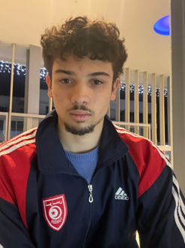
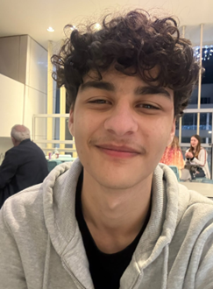
Team
Built by a team focused on student nightlife + venue partnerships in Nicosia.
Youssef Bouzgarrou
Adam Ramahi
Founder / CEO Product + execution
Marketing Chief Growth + partnerships
Hiring / needs
- Mobile engineering - Venue partnerships - Community moderation (later) - Design and content
WTG Nicosia | Confidential
Team

Slide 12
Ask
We are raising to launch the MVP in Nicosia, onboard venues, and prove repeat usage + B2B revenue.
Raise (fill)
Use of funds (fill)
Target round: [EUR ____] Instrument: [SAFE / equity] Runway: [__ months]
Product: finalize MVP + stability Data: seed venues/events + media GTM: student + venue onboarding Ops: support + safety tooling (phased)
Next milestones (90 days)
- Seed Nicosia dataset + launch beta - Onboard first partner venues - Validate weekly retention loop - Start paid promos pilot
Contact: youssefbouzgarrouyb@gmail.com
WTG Nicosia | Confidential
Ask

